Slide 1
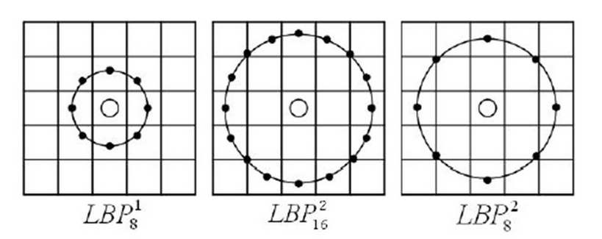
Local binary feature
Rotation, scale and lighting invariant
Quick and accurate
Randomly generate 1000 pair angle and radius and calculate the difference between them.
And choose the best one.(how to evaluate “best” ,later in random forest)

Slide 2
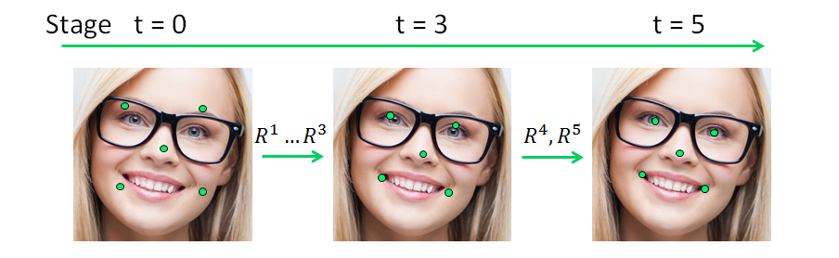
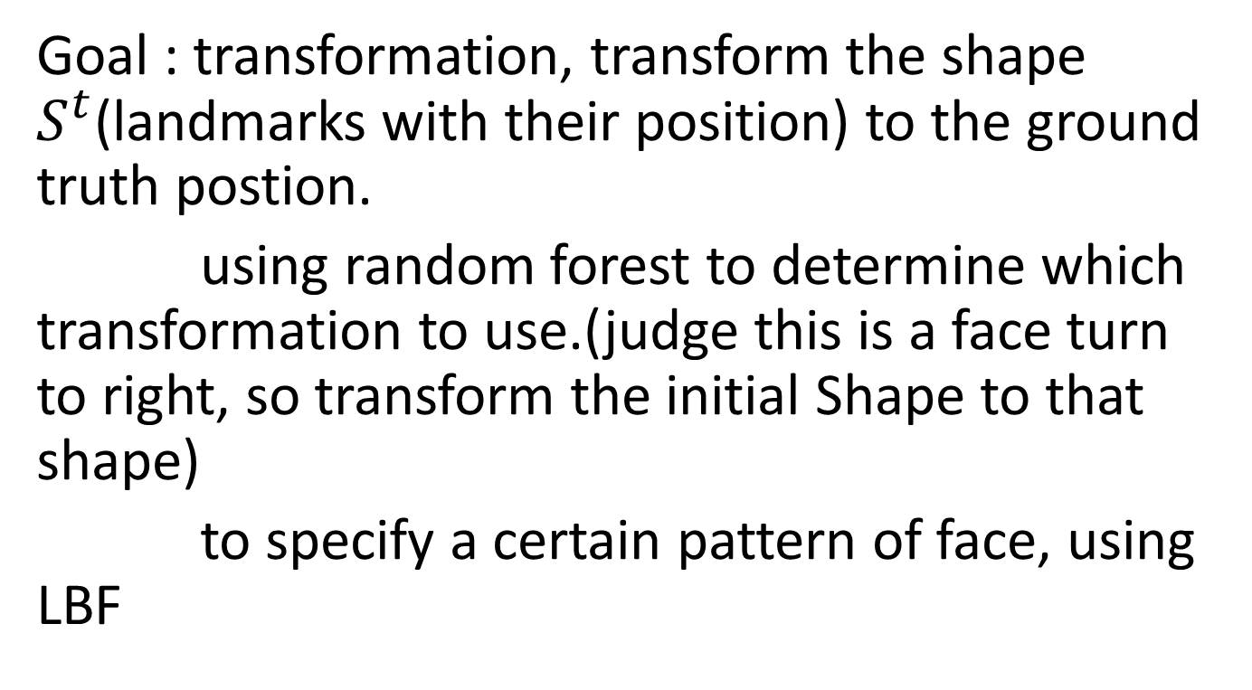
Random forest
Goal : transformation, transform the shape $S^{t}$(landmarks with their position) to the ground truth postion.
using random forest to determine which transformation to use.(judge this is a face turn to right, so transform the initial Shape to that shape)
to specify a certain pattern of face, using LBF

Slide 3
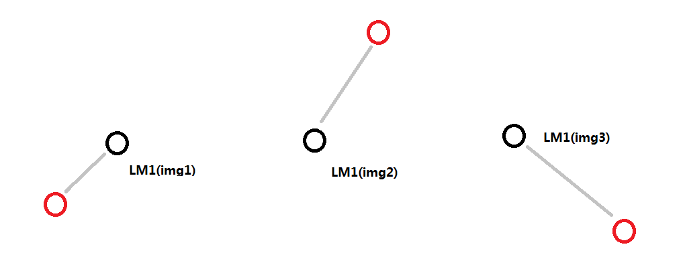
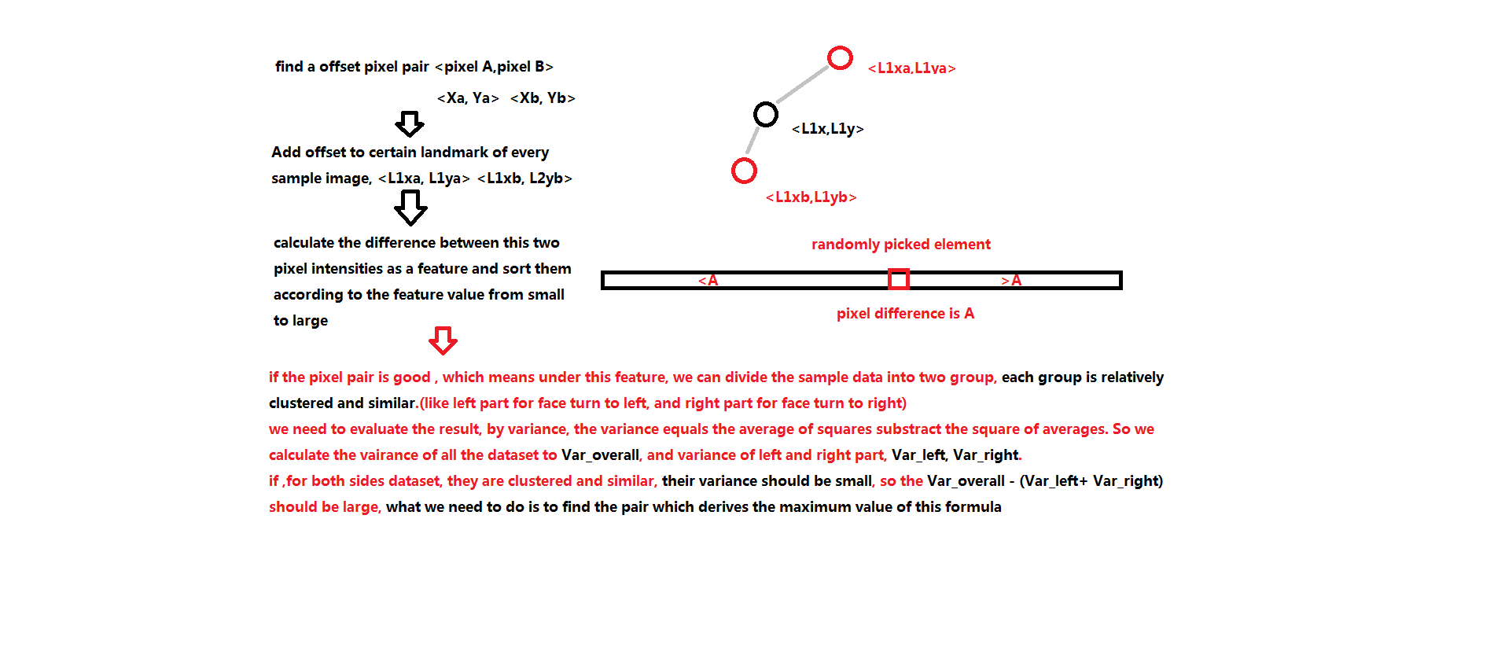
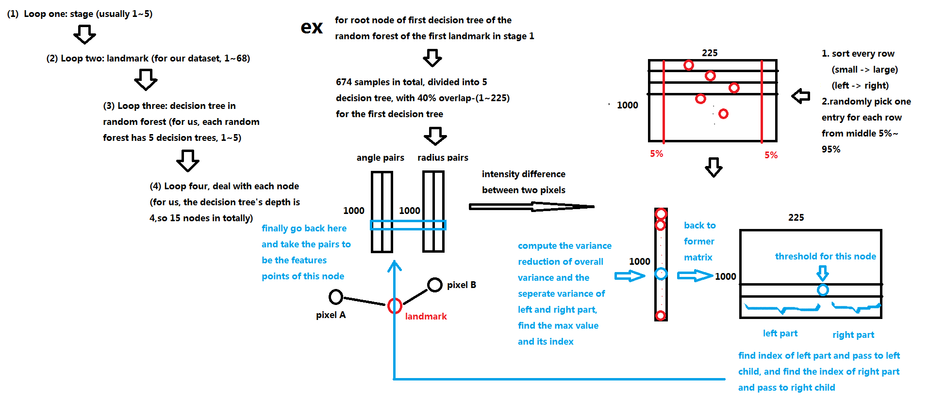
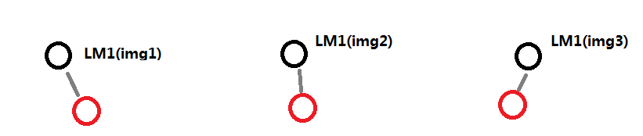
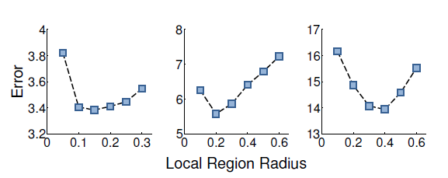
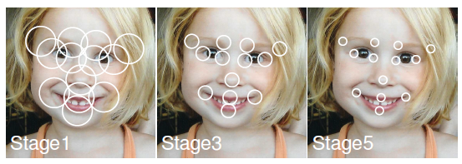

Slide 4
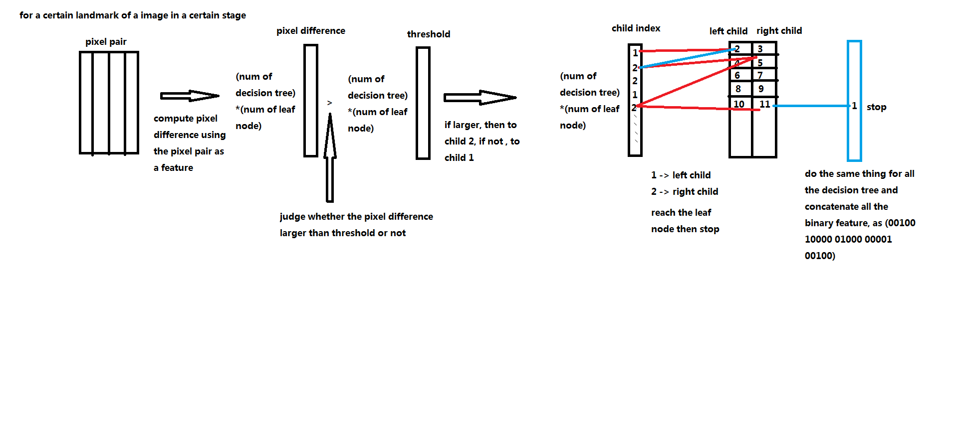
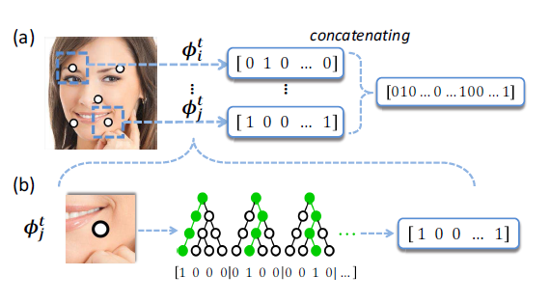
Derive binary feature

Slide 5
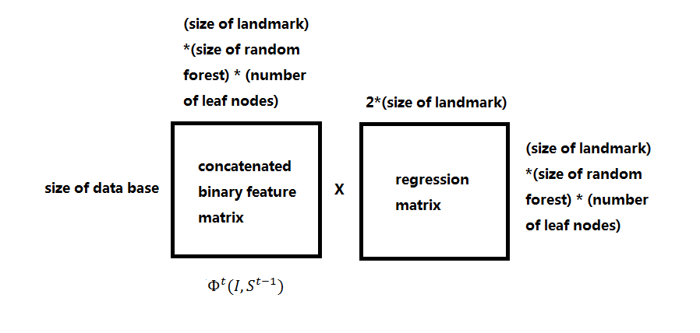
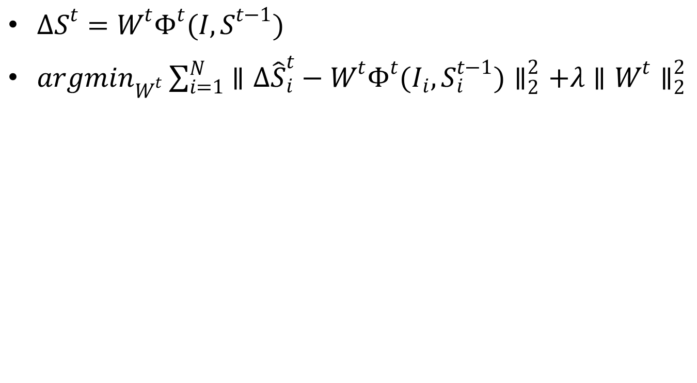
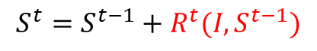
Global regression
$ΔS^{t}=W^{t}Φ^{t}(I,S^{t−1})$
${argmin}_{W^{t}}\sum_{i=1}^{N}{∥Δ{\hat{S}}_{i}^{t}−W^{t}Φ^{t}(I_{i},S_{i}^{t−1})∥_{2}^{2}+λ∥W^{t}∥_{2}^{2}}$
$$S^{t}=S^{t−1}+R^{t}(I, S^{t−1})$$

Slide 6
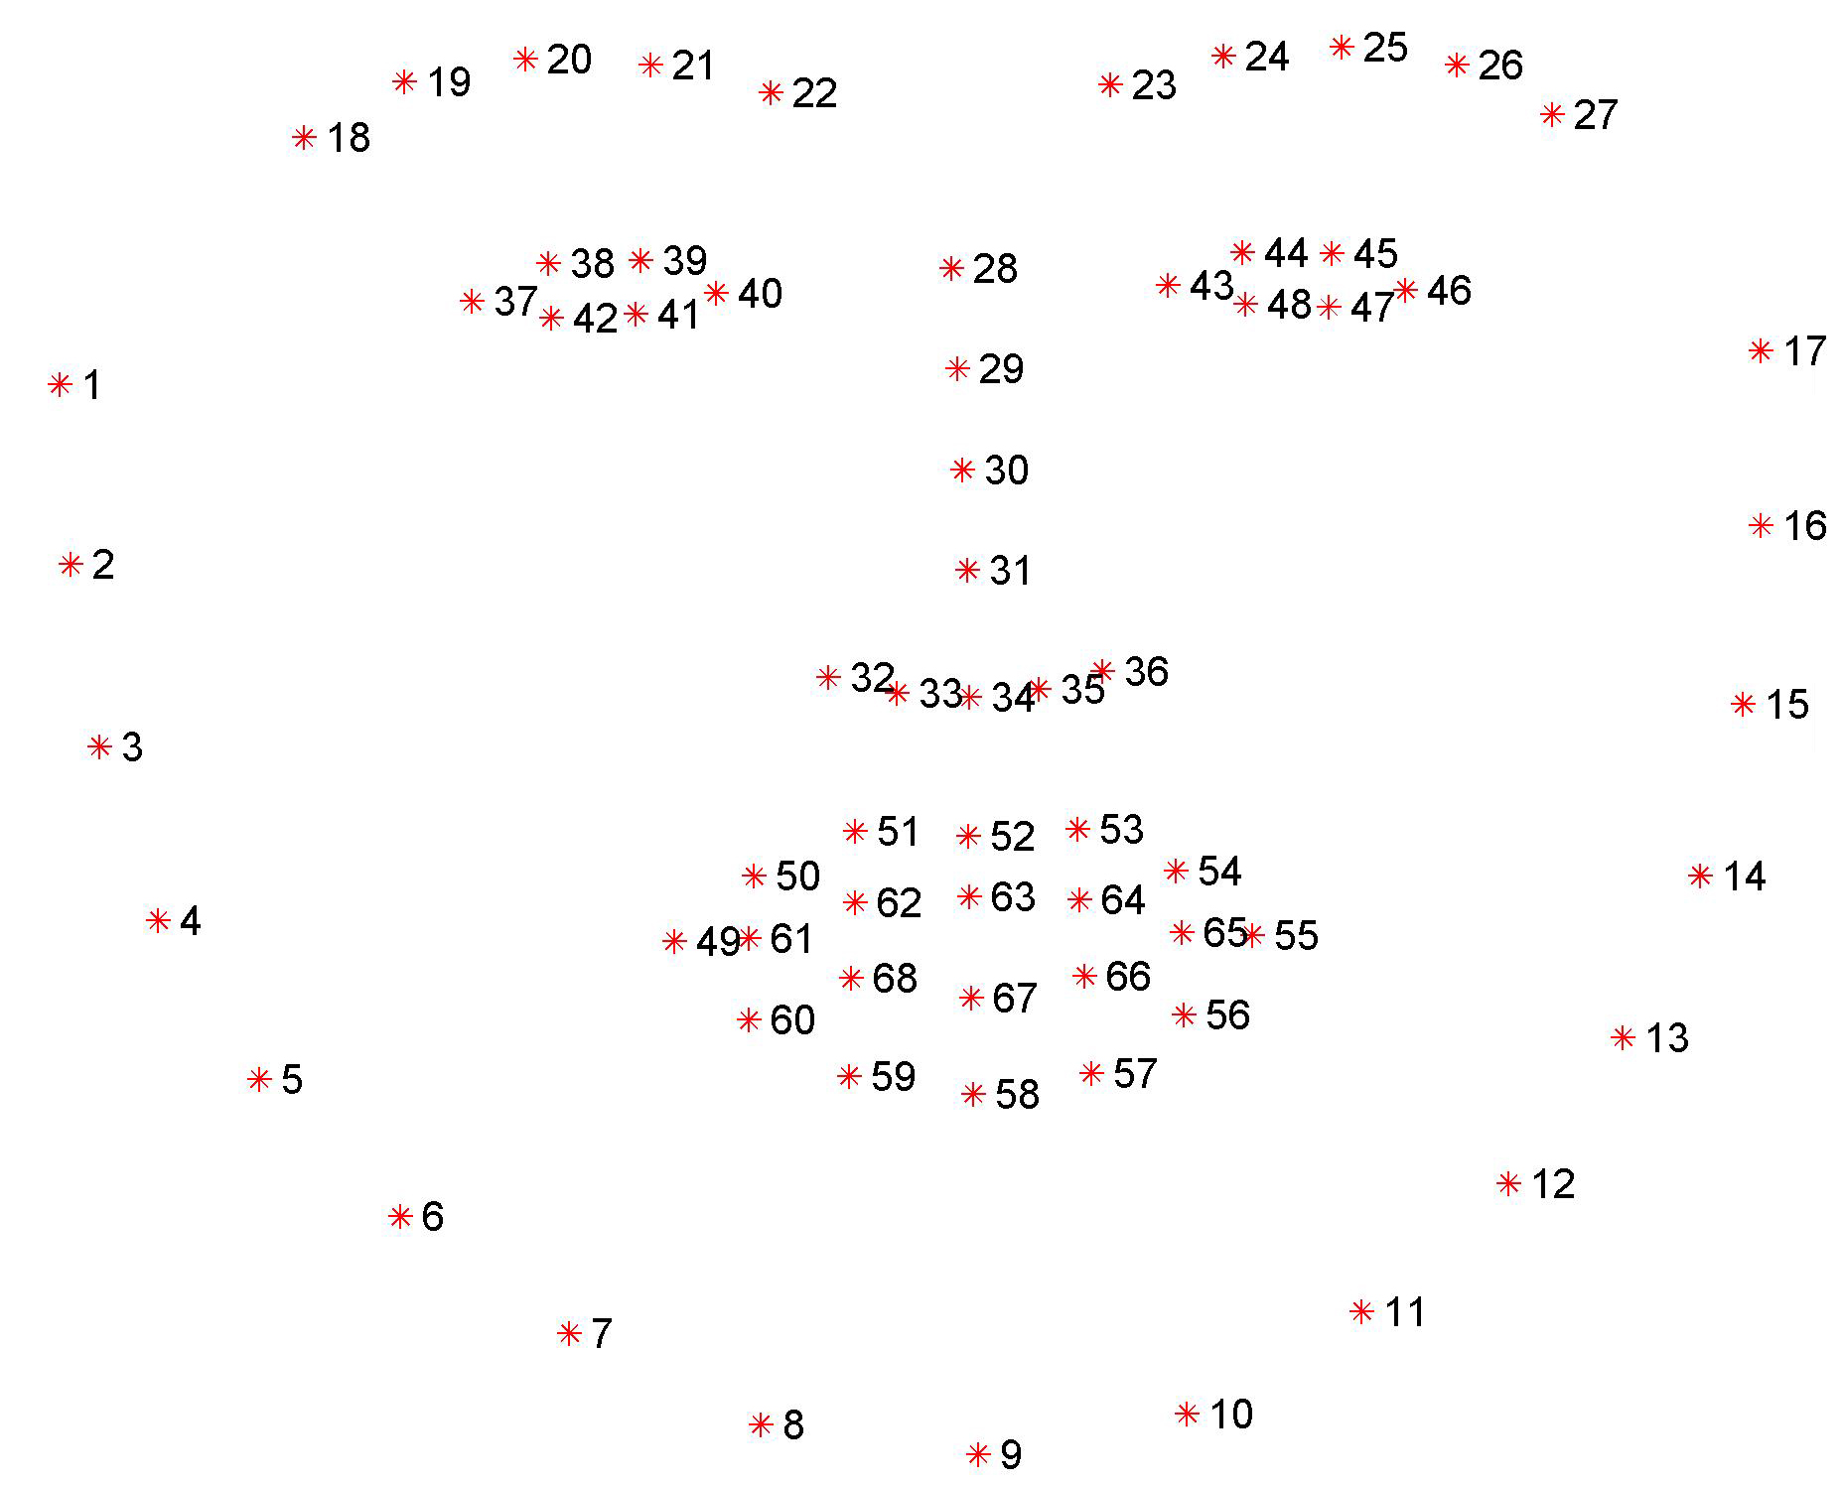
Experiment result

